Slide 1

Module 3.C
IEC Language : IL

Slide 2
IEC Language IL
Notes:
This page intentionally blank

Slide 3
Overview
Boolean machine language for numeric and logical processing
Conforms to IEC 61131
Very simple and easy to learn
Optimized and fast code for critical sections
Ideal for straightforward problems
Difficult to write, read and understand the program
Difficult to follow the program flow

Slide 4
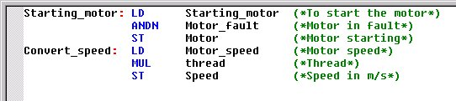
Instructions
A program in Instruction List is composed of a series of instructions.
Each instruction begins on a new line and consists of
  Label (optional) : locates a sequence in a program
  Operator : determines operation to be run
  Modifier : influences the execution of the operator
  Operand : is an object upon which an operator acts
  Comment (optional) : gives some information about the line
Starting_motor
LD
ANDN
Motor_Fault
(*Thread*)

Slide 5
Labels
must always be the first element in a line
must be unique in a section
are not case sensitive
can be 32 characters long (max.)
are separated by a colon ": "
are only permitted at the beginning of "Expressions"

Slide 6
Operators
The following instructions can be executed :
assignment (LD, ST, S, R)
logical (AND, OR, XOR, NOT)
arithmetic (ADD, SUB, MUL, DIV, MOD)
comparison (GT, GE, EQ, NE, LE, LT)
structure (JMP, RET, ")")
call (CAL, FUNCTIONSNAME, PROCEDURENAME)

Slide 7
See comments

Slide 8
See comments

Slide 9
Modifiers
N : used to invert the value of the operands bit by bit
C : the associated instruction is only performed if the value of the result is 1 (TRUE)
CN : modifiers C and N are combined, the associated instruction is only performed if the value of the result is 0 (FALSE)
"(" : used to move back the evaluation of the operand, until the right bracket operator ")" appears

Slide 10
Operands
An operand can be :
a direct address
a value
a symbolic variable
a multi-element variable
an element of a multi-element variable
an EFB/DFB output
an EFB/DFB call

Slide 11
Comments
In the IL editor, comments always start with the string "(*" and end in the string "*)".
Between these character sequences any comments can be entered.
Nesting comments is not allowed according to IEC 61131-3. But possible if the option is selected in the project options.

Slide 12
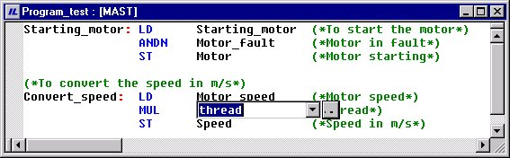
Language Editor
same aspect as a general editor (Wordpad) and complete function (copy/past, tab,...)
one instruction maximum per line
colors used to define the different objects
Background analysis of the entry (a syntax and semantics check carried out during program creation)
Entry help of variables, EF or FB-instances via dialog box
A line contains a maximum of 300 characters (instruction, comment, label)
Notes:
Feature
An instruction takes up a maximum of one line
The length of the section is not limited
The position of labels, symbol and comments are not fixed
Search and replace of pure text or variable, FB instances
The line and column numbers of the are displayed in the status bar
Cut, copy, paste, ...
Even sections containing mistakes (i.e. wrong syntax, variable not declared, ...) may be stored
Coloring and marking
If the cursor is placed over faulty text a Quickinfo (Tooltip) with a brief description of the cause of the error appears.

Slide 13
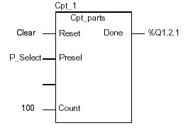
Programming rules
Variable
  entered directly or with the Data Wizard
Elementary Functions
  no required declaration
  EF used straight (without the CAL operator)
  entered directly or with the FFB Wizard
Elementary Function Blocks or Derived Function Block
  no required declaration (automatically defined with the FFB Wizard)
  EFB-instance used with CAL operator
  Formal or informal call
  entered directly or with the FFB Wizard
CAL Cpt_1 (Reset:=Clear, Presel:=%MD10, Count:=100)
...
LD Cpt_1.Done
ST %Q1.2.1
CAL Cpt_1 (Clear, %MD10,, 100)
...
LD Cpt_1.Done
ST %Q1.2.1

Slide 14
Program development
Create or open a section in Instruction List
Write the program and edit the used variables
  Enter Operator
  Enter or select operand (variable)
  Enter or select EFB/DFB-instance
Analyze the program editing frequently to check syntax
  Any errors found displayed in the output window
  Double click on the line to go to the line with the error in IL
Save the project
Generate the project to download
Transfer and connect the project to the PLC
Debugging the program in connected

Slide 15
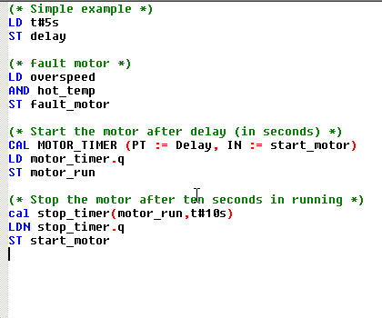
Programming example
Assignment
Logical AND
Formal EFB call with allocation
Informal EFB call with allocation

Slide 16
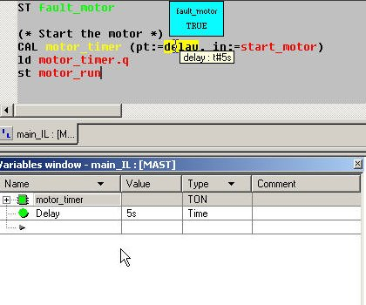
Debugging
Animation of IL section
  Boolean variable is true :
  Boolean variable is false :
  Other variable types :
The non-boolean type are not animated in the editor but in :
  Screen tips
  Inspection windows
  Variable display window
  Animation tables
Green
Red
Yellow

